Slide 1
LENDING CLUB ASSIGNMENT SUBMISSION
Name: Pankhuri Mishra

Slide 2
How should online loan marketplace reject or approve loan request?
Problem Statement :
As employee for consumer finance company which specializes in lending various loans to urban customers online, I want to define a strategy to approve and reject a loan request from the applicant given the records of past loan applicants
Risks involved:
Rejecting loan if likely to repay the loan will result in loss of business to the company
Approving loan not likely to repay the loan will result in financial loss to the company
Given:
Loan' dataset with applicant, loan, miscellaneous translation details in 111 different attributes
Data Dictionary with metadata information for all the variables in loan dataset
Goals of data analysis:
Identify the trend of the loan applicants
Identify the driving factors indicators of the defaulters (Charged-off). These factors make the applicant at high risk i.e. loan cannot be approved
Identify the driving factors indicators the defaulters (Fully paid). These factors make the applicant at low risk i.e. loan can be approved

Slide 3
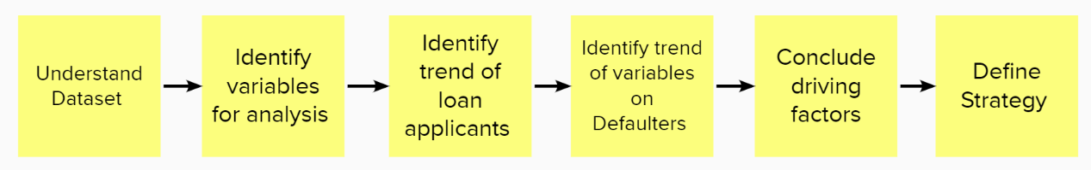
Problem solving methodology

Slide 4
Analysis : Data Inspection
Understand the Loan Dataset:
Loan dataset has 111 variables
These provide details of the applicant , loan and applicant credit history
Following variables which will add value to further analysis
addr_state
annual_inc
emp_length
home_ownership
verification_status
dti
application_type
term
grade
installment
int_rate
issue_d
loan_amnt
loan_status
purpose
pub_rec_bankruptcies
pub_rec
annual_inc_joint
verification_status_joint
dti_joint
home_ownership
verification_status
dti

Slide 5
Analysis : Data Cleaning
Identify variables for analysis
The variables related to joint do not have relevant information and can be dropped.
Drop the missing values in dataset i.e. emp_length, pub_rec_bankruptcies
Our Target variable is loan-status. We are interested in Fully Paid, Charged Off value
We can limit further analysis to the limited dataset
addr_state
annual_inc
emp_length
home_ownership
verification_status
dti
term
grade
installment
int_rate
issue_d
loan_amnt
loan_status
purpose
pub_rec
pub_rec_bankruptcies

Slide 6
Analysis : Analyse variables
Identify trend for loan applicants
Annual Income
Most of the applicants have limited income - no source of income or minimum source of income.
There are few outliers which can be excluded from the analysis
Its safe to remove the outliers , applicant earning more than 1000000 can be excluded from the dataset
Loan Amount
Range of the loan processed is 5000-15000 with significant loan requests beyond 30000
Instalment
Installments primary range is 167-429
Many outliers beyond 800
Issue Date Issue Date
Number of application has been rapidly increasing since 2007
Interest Rate
8-14 is the typical interest rate for the loan issued

Slide 7
Analysis Contd.
Impact of other variables on target variable
Home Ownership
Most of the applicants have rented property
Applicants having Mortgage are too significant loan applicants
Significant ratio of rented or mortgage property are among Charged Off applicants
Medi Risk : Other (Need to look for reason though)
Verification Status
Most of the applicants are not verified
Verified applicants and Not Verified both have similar number of charged off applicants
Verification state is not a significant factor for charged off loans, though Not verified applicants have more chances to repay the loan amount
Grade
Most of the loan grades are from B, A, C
B, C, D have similar rang of applicants
Higher the loan grade, more chances are for defaulter. Grade D and above are high risk

Slide 8
Analysis Contd.
Employment
Most of the applicants have no or less than 2 years of experience. They are able to fully pay the loan
Significant number of applicants have 2-5 years exp.
Though there is significant dip in 6-8 years exp, 8+ years exp are applying for loan increase again
Looks like people after gaining experience are venturing in small business, which are adding debt and increasing chances of defaulters
Purpose
Most popular reason of the loan is to pay off other liabilities. Significant number of applicants taking loan for this reason are among the defaulters
The next top reason for loan is to pay credit card bills
Significant number of applicants have 2-5 years exp.
Though there is significant dip in 6-8 years exp, 8+ years exp are applying for loan increase again
Loan Amount
Most loan requests are for 5-10K US. 0-5K and 10-15K is next frequent loan request
As the loan amount increases the percentage of defaulting increases. Especially for 25-35K range

Slide 9
Analysis Contd.
State
Top loan applicants are from CA, NY, FL
In a way this confirms that most small businesses are setup in few specific states
Term
Loan applicants have only 2 options of terms
Higher chance of default if the term is for 60 months
This implies, if the loan amount is larger the term to repay the installment is longer. Of course, the higher the amount, more difficult to repay.
Bankruptcies
Very less loan applicants have bankruptcies. Its obvious to bankrupt people are less likely to repay the loan
Only 5 applicant have declared bankruptcies 2 times
DTI
Top loan applicants have 10-15 DTI

Slide 10
Analysis Contd.
Conclude driving factors
We have few variables having direct impact on the target variable
Focussing on the factors for defaulters i.e. % Charged Off loan status, risk factor can be defined as below:
Very Low Risk i.e. less than 10% Charged Off loan applicants
Low Risk i.e. 10 -15% Charged Off loan applicants
Medium Risk i.e. 15-20% Charged Off loan applicants
High Risk i.e. 20-25% Charged Off loan applicants
Very High Risk i.e. more than 25% Charged Off loan applicants
Home Ownership, Verification status, Employment, State, DTI have some impact on the Fully Paid and Charged Off .Low-Medium risk areas can be identified. For example ,
Loan applicants having rented property are at higher risk than those having own property.
Loan requests for small business are at very high risk
Loan grade, purpose of loan, loan amount, loan term, public bankruptcies have significant impact on Fully Paid and Charged Off.
Criteria's can be identified from historical data to identify the low risk, high risk factors
These factors needs to be accounted once approving / rejecting the loan request especially when a loan applicant has Medium to High risk factors identified

Slide 11
Risk Factors
 | Very Low Risk (less than 10% Charged Off) | Low Risk (10- 15% Charged Off)) | Medium Risk (15-20% Charged Off)) | High Risk (20-25% Charged Off)) | Very High Risk (25% and above Charged Off))
Home Ownership |  | MORTGAGE/OWN | Other/ RENT
Verification Status |  | NOT VERIFIED/ SOURCE VERIFIED | VERIFIED
Grade | A | B | C | D | E,F,G
Employment |  | 0-8 years | 8+ years
Purpose | WEDDING | CAR, CREDIT CARD, HOME IMPROVEMENT, MAJOR PURCHASE, MOVING, VACATION | DEBT CONSOLIDATION, EDUCATIONAL, HOUSE, MEDICAL, OTHER, RENEWABLE ENERGY, |  | SMALL BUSINESS
Loan Amount |  | 0-15K | 15-25K | 25-35K
State(>500 applicants) |  | AZ, CO, CT, IL, MA, MI,MN, NC,NY,OH, PA,TX,VA, | CA, FL, GA, MD, MO, NJ,WA,
Term |  | 36 months |  |  | 60 months
Public Bankruptcies |  | 0 |  | 1 | 2
DTI |  | 0-15, 25-30 | 15-25

Slide 12
Analysis Contd.
Define Strategy

Slide 13
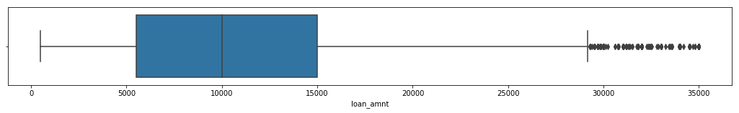
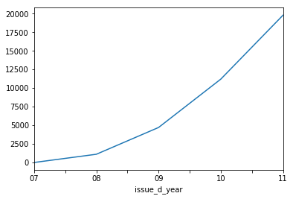
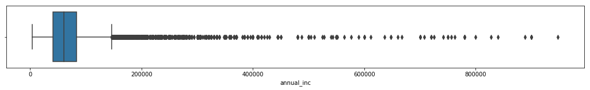
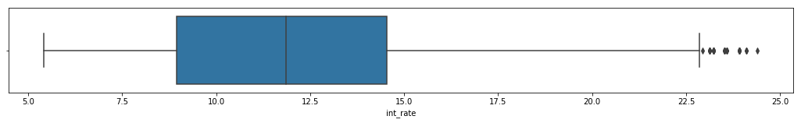
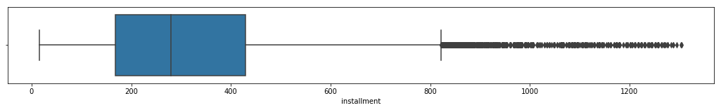
Behavior of loan applicants

Slide 14
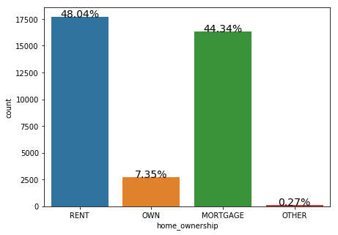
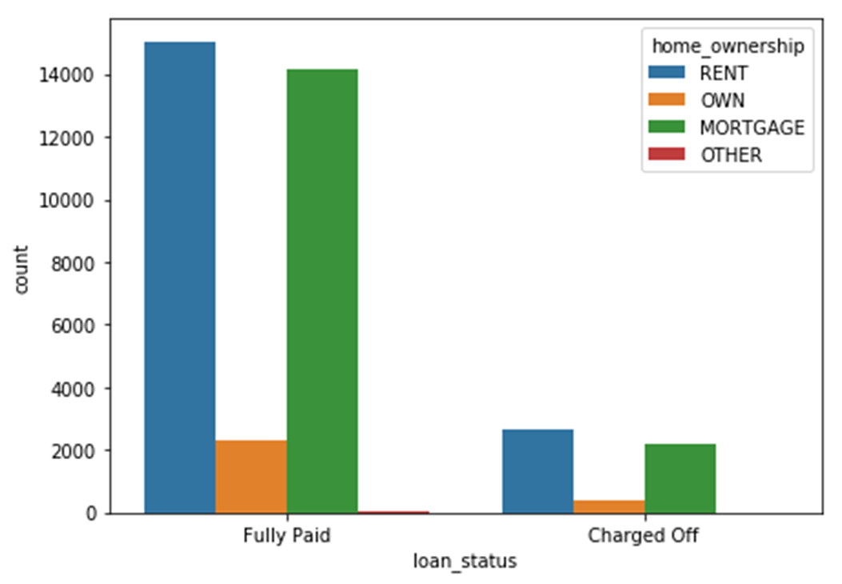
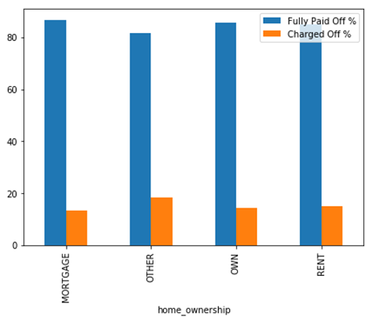
Impact of Home Ownership

Slide 15
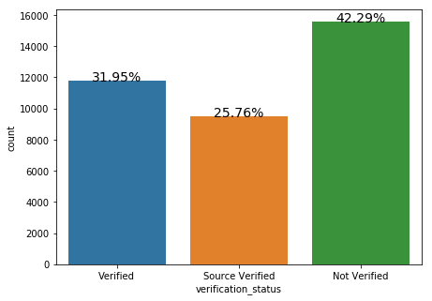
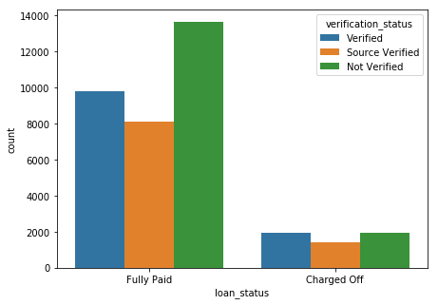
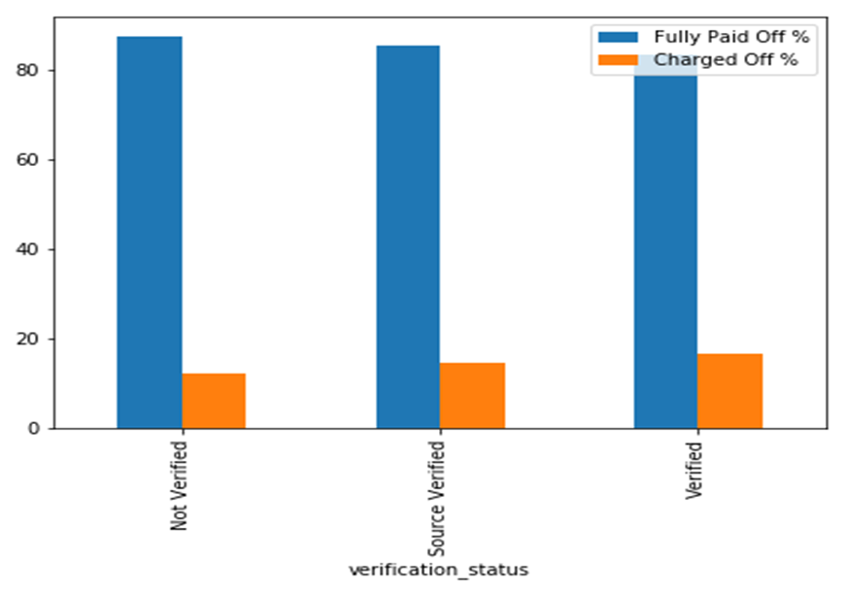
Impact of Verification Status

Slide 16
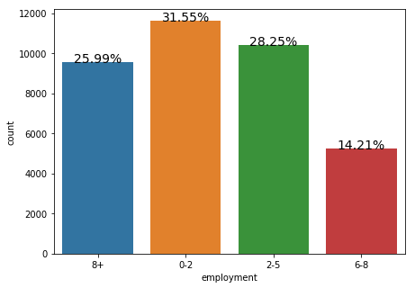
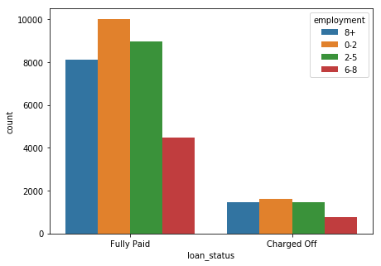
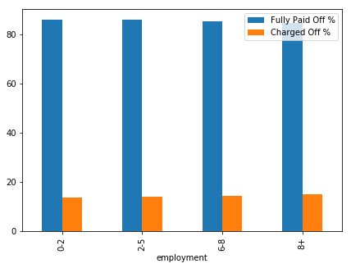
Impact of Employment

Slide 17
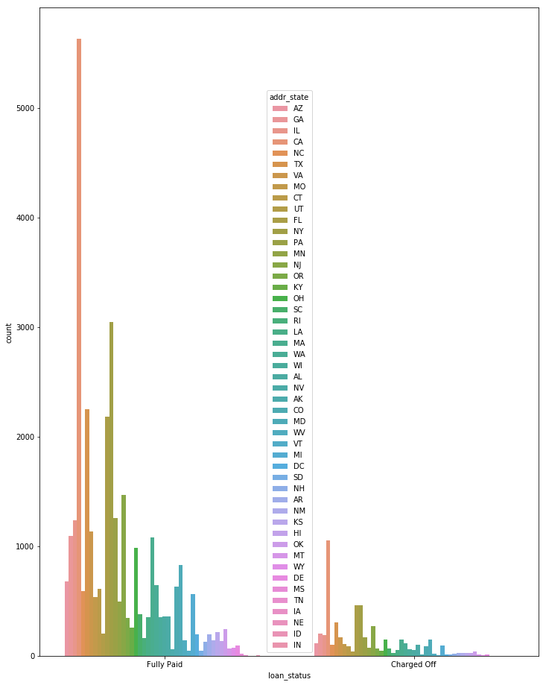
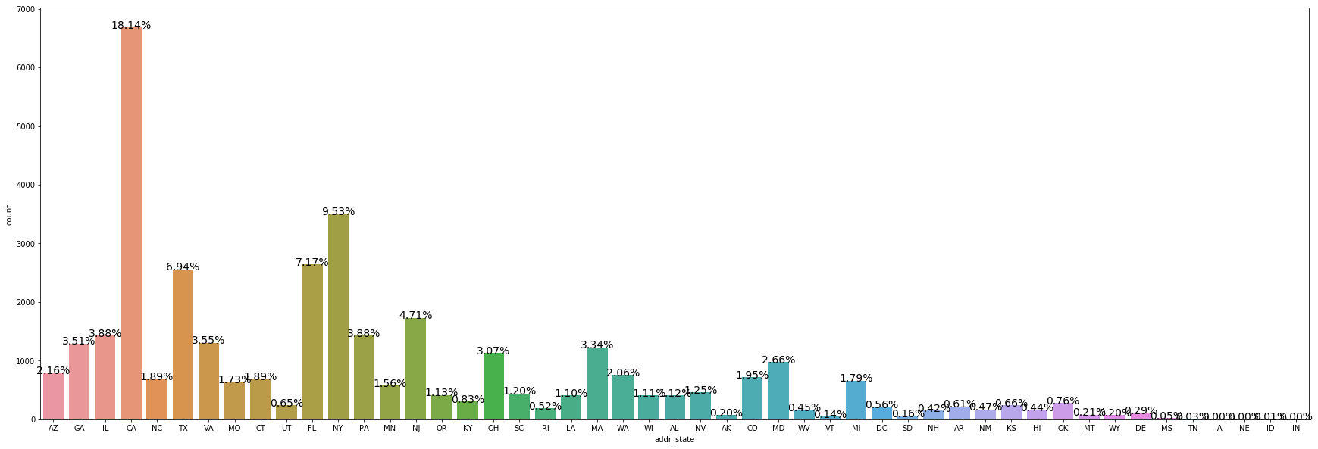
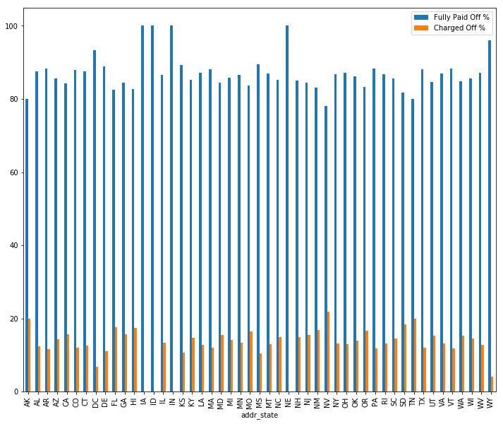
Impact of State

Slide 18
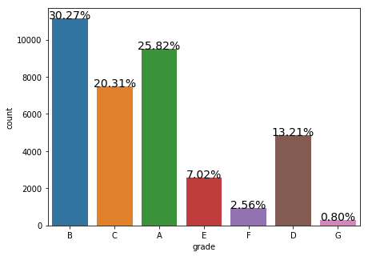
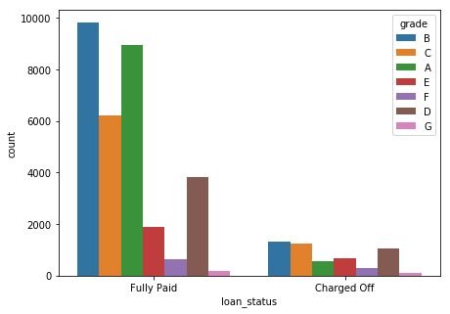
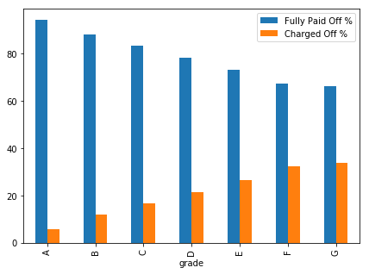
Impact of Grade

Slide 19
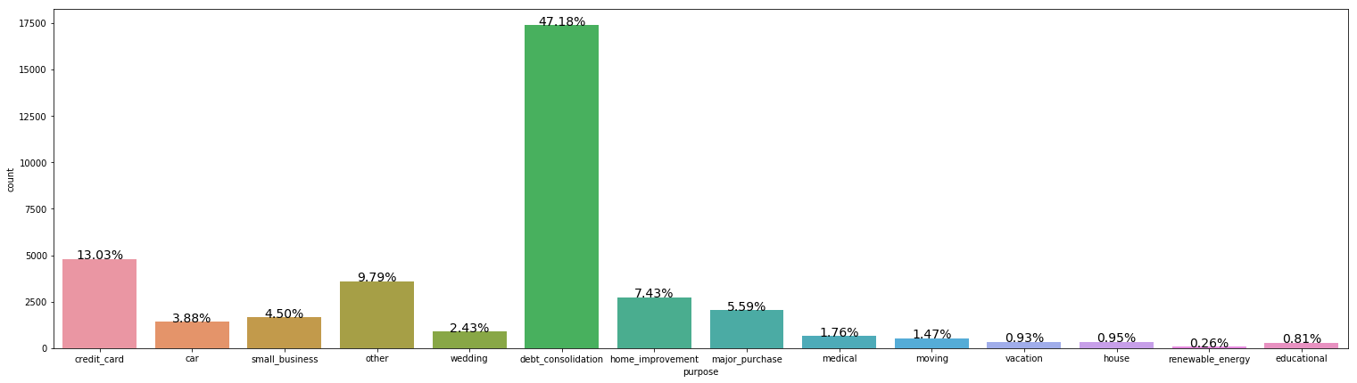
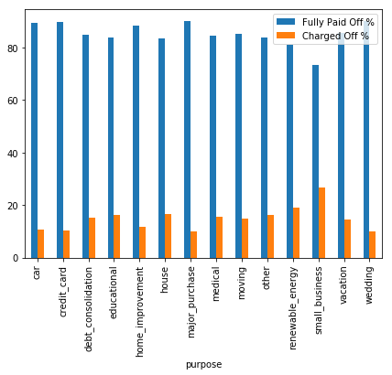
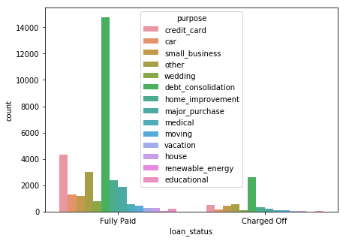
Impact of Loan Purpose

Slide 20
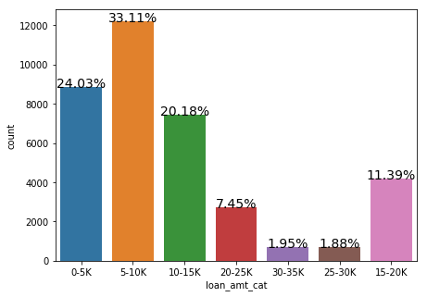
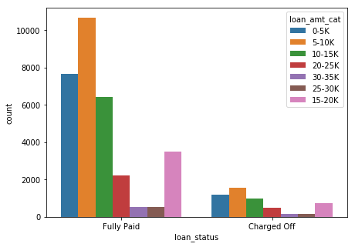
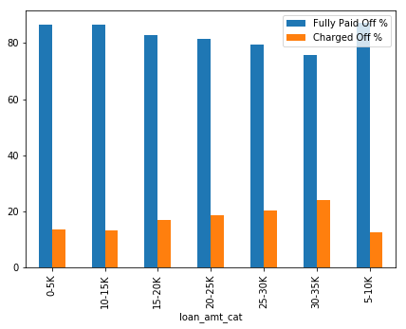
Impact of Loan Amount

Slide 21
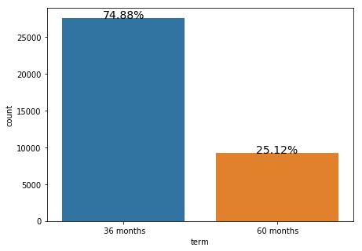
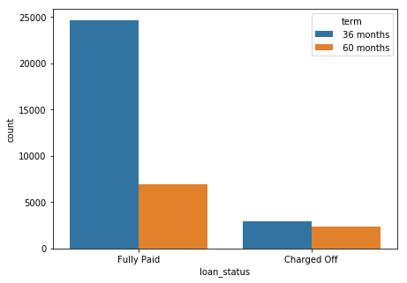
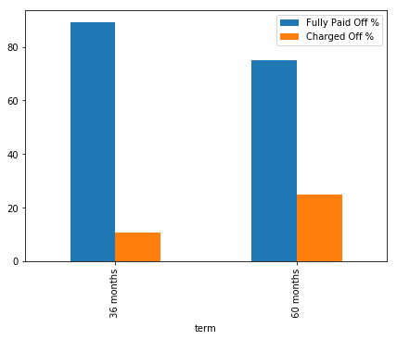
Impact of Loan term

Slide 22
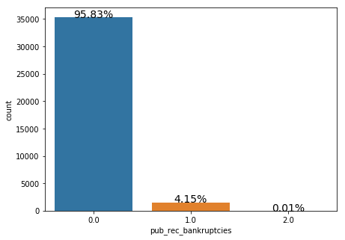
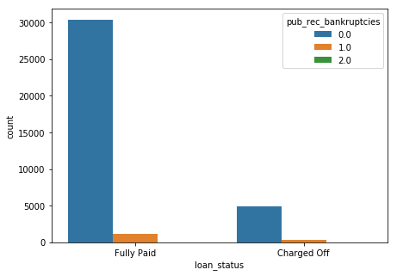
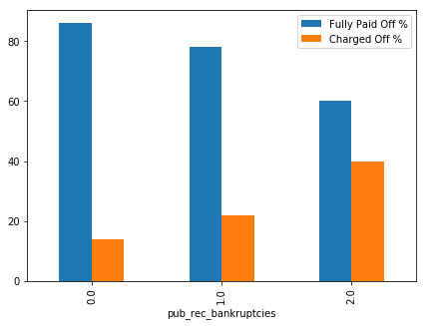
Impact of Bankruptcy

Slide 23
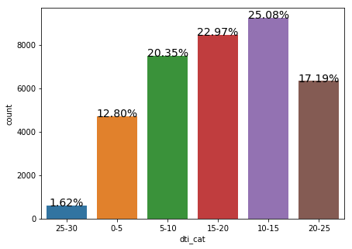
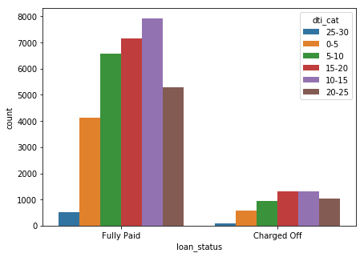
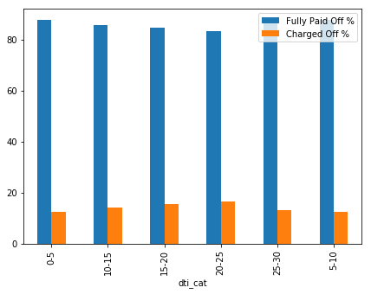
Impact of DTI

Slide 24
Conclusion
Driving Factors for Charged Off applicants :
Home Ownership, Verification status, Employment, State, DTI are Low to Medium Risk factors
Loan grade, purpose of loan, loan amount, loan term, public bankruptcies are Medium to High Risk Factors

